Slide 1
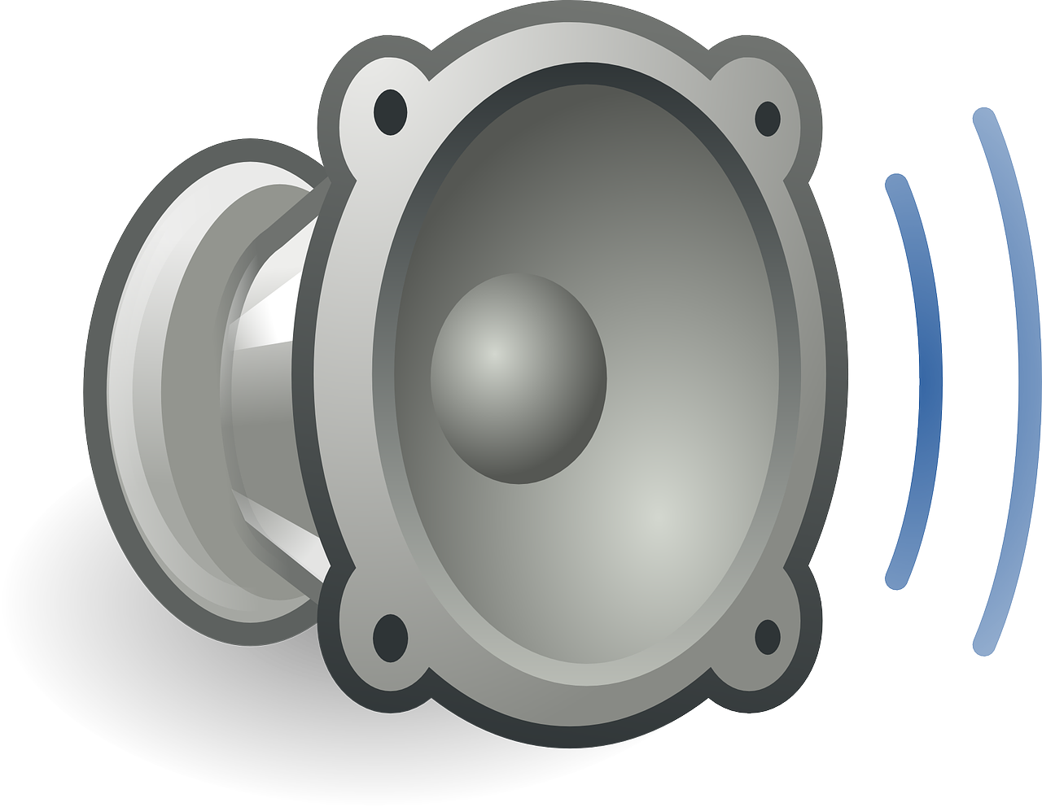

Slide 3
Speaker Diaphragm
Sound Data
or
Electrical Current
Electricity going though wire
Sound Waves
Electromagnetic force from electricity

